Slide 1
3.2 NXT Firmware U3C2

Slide 2
3.2 Firmware
Overview:
The goal of this lesson is to explore the concept of firmware using the NXT. Students will connect the NXT to a computer to download firmware and explore its contents.
Objectives: Student will be able to:
1. Distinguish firmware from software
2. Explain the role of the NXT firmware
3. Update the NXT firmware
Notes:
Published on STEMRobotics (http://stemrobotics.cs.pdx.edu)
Home > NXT Firmware
Lesson: NXT Firmware [1]
Submitted by Randy Steele [2] on 12 July, 2011 - 19:19
Overview:
The goal of this lesson is to explore the concept of firmware using the NXT. Students will connect the NXT to a computer to download firmware and explore its contents.
Objectives: Student will be able to:
1. Distinguish firmware from software
2. Explain the role of the NXT firmware
3. Update the NXT firmware
Instruction Guide:
NXT Firmware [10]
Primary Instructional Material:
NXT Firmware [11]
Differentiated Instruction Material: Alternative:
NXT Firmware (incl. Summative Assessment) [12]
Differentiated Instruction Material: Supplemental:
NXT Firmware_Video [13]
Formative Assessment:
NXT Firmware_Starters [14]
NXT Firmware (with Formative Assessment) [15]
Summative Assessment:
NXT Firmware_Worksheet [16]
Education Level: Middle School [17]High School [18]Scope & Sequence: Robotics [19]Focus Subject: Computing / Computer Science [20]Robotics Hardware [21]Robotics Software [22]HW Platform: NXT [23]SW Platform: NXT-G [24]Interactivity Style: Mixed [25]Copyright 2011 (c) by the author. All rights reserved.Source URL: http://stemrobotics.cs.pdx.edu/node/399

Slide 3
Task Assignment NXT Firmware
Name:_________________________ Period:___ Date:________ Score:_____/10
From within NXT-G, open a new program and then open the “NXT Window”
(1/2 pt) What is your battery voltage level?
(1/2 pt) What is the name of your NXT Brick (you can change it if you like)?
(1/2 pt) What firmware version does your brick have? Follow the “Downloading Firmware” Video in Video Trainer 2 – Basics (Note: Do not update the firmware if the version on your brick is newer than the one offered by the NXT-G firmware update screen. Also, do not proceed to the next video as instructed at the end of this video)
Answer the four Questions at the end of the video: (1 pt) (1 pt) (1 pt) (1 pt)
(1 pt) What firmware version does your brick have after the update?
(1 pt) How much Free Storage space does your brick have after the update?
(1 pt) What files are located in the memory after the update (select “Memory” in NXT Window screen)? Delete all the programs in the memory
(1 pt) How much Free Storage space does your brick have after deleting all the files?
(1/2 pt) What is your battery voltage level now?
Notes:
Task Assignment
NXT Firmware
Name:_________________________ Period:___ Date:________ Score:_____/10
From within NXT-G, open a new program and then open the “NXT Window” What is your battery voltage level? What is the name of your NXT Brick (you can change it if you like)? What firmware version does your brick have? Follow the “Downloading Firmware” Video in Video Trainer 2 – Basics (Note: Do not update the firmware if the version on your brick is newer than the one offered by the NXT-G firmware update screen. Also, do not proceed to the next video as instructed at the end of this video) Answer the four Questions at the end of the video: What firmware version does your brick have after the update? How much Free Storage space does your brick have after the update? What files are located in the memory after the update (select “Memory” in NXT Window screen)? Delete all the programs in the memory How much Free Storage space does your brick have after deleting all the files? What is your battery voltage level now?

Slide 4
NXT Video
NXT Firmware Video (17.56)
Notes:
Published on STEMRobotics (http://stemrobotics.cs.pdx.edu)
Home > NXT Firmware_Video
Instructional Material:
NXT Firmware_Video [1]
Submitted by Randy Steele [2] on 12 July, 2011 - 19:45
This Editor Introduction video [5] was developed by Dale Yocum (Catlin Gabel School, Portland, OR) as part of his NXT Tutorial series. These videos have been linked as Differentiated Instructional Resources in their corresponding lessons in STEM Robo101. This Editor Introduction video covers some of the features used in the Firmware lab and other capabilities of the NXT-G editor that will be used in future lessons.
Material Type: Tutorial
Education Level:
Middle School [6]
High School [7]
Focus Subject:
Engineering [8]
Humanities [9]
Mathematics [10]
Robotics Hardware [11]
Robotics Software [12]
Science [13]
Technology [14]
HW Platform:
NXT [15]
SW Platform:
NXT-G [16]
Interactivity Style:
Mixed [17]
Copyright (c) 2011 by the author. All rights reserved.
Source URL: http://stemrobotics.cs.pdx.edu/node/404

Slide 5
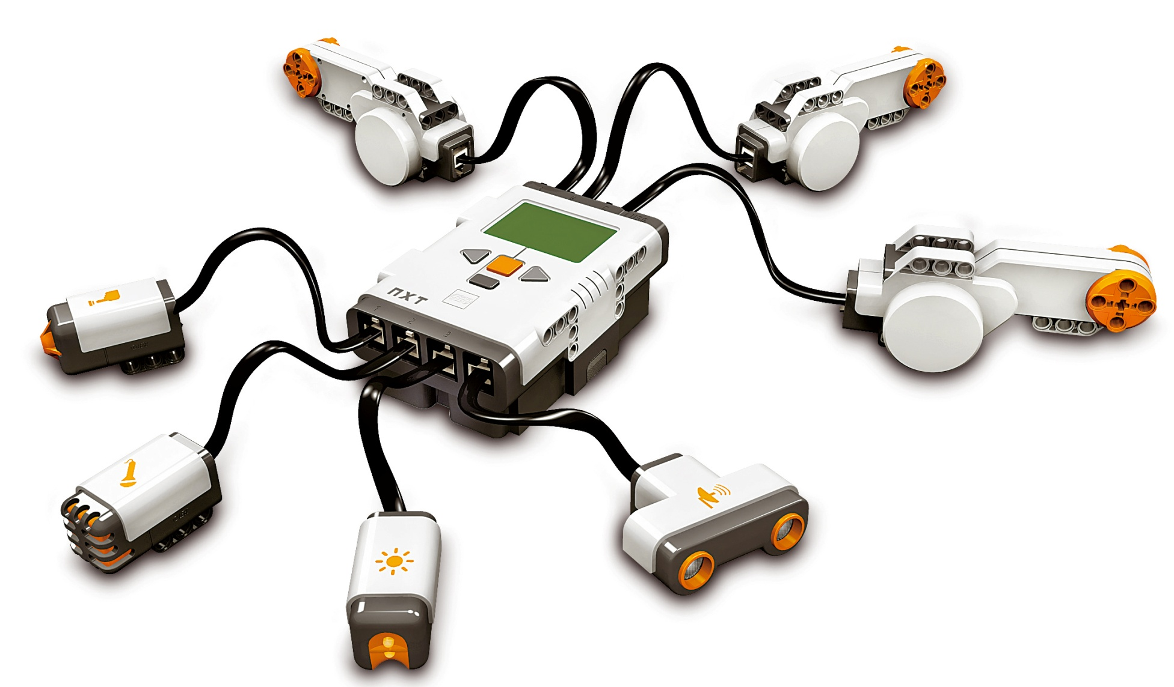
The NXT
Hardware, Software & Firmware
NXT Hardware:
Anything you
Can see or touch
NXT Software:
Programs written by you
Firmware:
Programs/
Instructions written by the
manufacturer
Notes:
Published on STEMRobotics (http://stemrobotics.cs.pdx.edu)
Home > NXT Firmware
Instruction Guide:
NXT Firmware [1]
Submitted by Randy Steele [2] on 12 July, 2011 - 19:19
Walk through NXT Hardware, Software, Firmware PPT [10]with students
Slide 1
Hardware is the physical, tangible pieces
Anything you can see or touch
Software is the instructions given to the hardware by the user (student)
The programs the students will write
Firmware is the instructions given to the hardware by the manufacturer (Lego)
Most of these instructions are not visible or accessible by the students
These hidden instructions tell the NXT what to do when it is turned on and how to interpret the programs that the students will write
A few sample programs can be deleted by students to make more room for their programs
Slide 2
Remind students the NXT Flash memory is located in the chips inside the NXT Brick
Slide 3
The NXT Flash memory is 256KB (Kilobytes) in size
CD quality music is roughly 1MB (Megabyte) per minute
NXT Flash Memory would only hold about 15 seconds of CD quality music
Remind students they can view the Flash Memory contents with the “NXT window”
From the NXT-G software, this is the upper left button (with the embossed NXT Brick symbol) in the control cluster
This was “Procedure 1” from the demo in the “ NXT Computer" lesson
Note the version number of the firmware
Note that the Free Storage is much less than 256KB
The firmware (both hidden and unhidden portions) are using over half the Flash Memory
Some of the unhidden manufacturer programs are listed on the left side of the Memory window
Deleting this programs will free up more space for the students files
Students will need to periodically come to this window and delete files they are not using anymore to free up space for their new programs
Downloading NXT Firmware
Have students complete NXT Firmware Task Assignment [11]
This will be the student’s first direct use of the NXT Video Trainer 2 and NXT-G software
Have student open both programs
Connect NXT Brick to computer with USB cable
Follow the steps in the Task Assignment
Source URL: http://stemrobotics.cs.pdx.edu/node/398

Slide 6
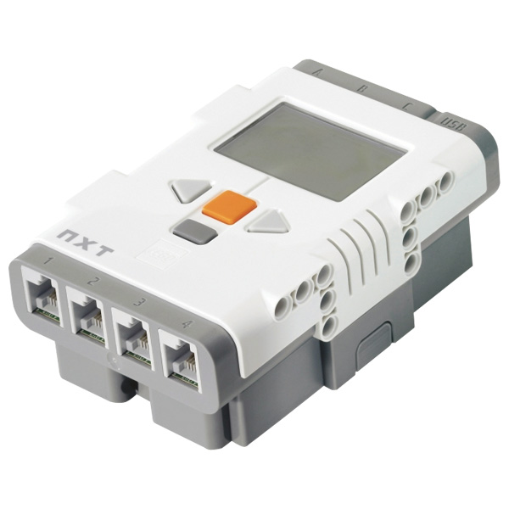
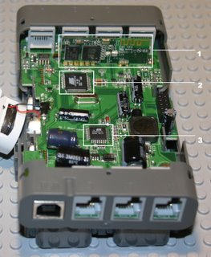
NXT Brick Hardware
Processor and Memory chips
Firmware is stored in Flash Memory
Notes:
Slide 2
Remind students the NXT Flash memory is located in the chips inside the NXT Brick
Slide 3
The NXT Flash memory is 256KB (Kilobytes) in size
CD quality music is roughly 1MB (Megabyte) per minute
NXT Flash Memory would only hold about 15 seconds of CD quality music
Remind students they can view the Flash Memory contents with the “NXT window”
From the NXT-G software, this is the upper left button (with the embossed NXT Brick symbol) in the control cluster
This was “Procedure 1” from the demo in the “ NXT Computer" lesson
Note the version number of the firmware
Note that the Free Storage is much less than 256KB
The firmware (both hidden and unhidden portions) are using over half the Flash Memory
Some of the unhidden manufacturer programs are listed on the left side of the Memory window
Deleting this programs will free up more space for the students files
Students will need to periodically come to this window and delete files they are not using anymore to free up space for their new programs
Downloading NXT Firmware
Have students complete NXT Firmware Task Assignment [11]
This will be the student’s first direct use of the NXT Video Trainer 2 and NXT-G software
Have student open both programs
Connect NXT Brick to computer with USB cable
Follow the steps in the Task Assignment
Source URL: http://stemrobotics.cs.pdx.edu/node/398

Slide 7
Review Question 1
Which of the following is NOT an example of NXT hardware:
A) NXT Brick
B) Connecting Wires
C) Sound Sensor Try Me Pgm
D) Motor
E) None of the above
F) All of the above

Slide 8
Review Question 1
Which of the following is NOT an example of NXT hardware:
A) NXT Brick
B) Connecting Wires
C) Sound Sensor Try Me Pgm
D) Motor
E) None of the above
F) All of the above

Slide 9
Review Question 2
Which of the following is an example of NXT firmware:
A) Programs written by students
B) Programs written by teachers
C) Programs written by Lego
D) All of the above
E) None of the above

Slide 10
Review Question 2
Which of the following is an example of NXT firmware:
A) Programs written by students
B) Programs written by teachers
C) Programs written by Lego
D) All of the above
E) None of the above
Notes:
Firmware is the instructions given to the hardware by the manufacturer (Lego)
Most of these instructions are not visible or accessible by the students
These hidden instructions tell the NXT what to do when it is turned on and how to interpret the programs that the students will write
A few sample programs can be deleted by students to make more room for their programs

Slide 11
Review Question 3
Where are the your software programs stored:
A) In the NXT Brick’s processor
B) In the NXT Brick’s flash memory
C) On the NXT Brick’s screen
D) In the NXT Brick’s buttons
E) None of the above

Slide 12
Review Question 3
Where are the your software programs stored:
A) In the NXT Brick’s processor
B) In the NXT Brick’s flash memory
C) On the NXT Brick’s screen
D) In the NXT Brick’s buttons
E) None of the above

Slide 13
NXT Flash Memory
NXT Flash Memory is 256KB in size (~ 15 s. of music)
Contents can be viewed from “NXT window”
Firmware takes up over half
Remainder is for NXT file system
Programs, Sound Files, Graphic Files, Data Files, etc.
Deleting unused programs and files frees up space
Notes:
Slide 3
The NXT Flash memory is 256KB (Kilobytes) in size
CD quality music is roughly 1MB (Megabyte) per minute
NXT Flash Memory would only hold about 15 seconds of CD quality music
Remind students they can view the Flash Memory contents with the “NXT window”
From the NXT-G software, this is the upper left button (with the embossed NXT Brick symbol) in the control cluster
This was “Procedure 1” from the demo in the “ NXT Computer" lesson
Note the version number of the firmware
Note that the Free Storage is much less than 256KB
The firmware (both hidden and unhidden portions) are using over half the Flash Memory
Some of the unhidden manufacturer programs are listed on the left side of the Memory window
Deleting this programs will free up more space for the students files
Students will need to periodically come to this window and delete files they are not using anymore to free up space for their new programs
Downloading NXT Firmware
Have students complete NXT Firmware Task Assignment [11]
This will be the student’s first direct use of the NXT Video Trainer 2 and NXT-G software
Have student open both programs
Connect NXT Brick to computer with USB cable
Follow the steps in the Task Assignment
Source URL: http://stemrobotics.cs.pdx.edu/node/398

Slide 14
Review Question 4
What information is stored in the NXT Brick’s flash memory:
A) Lego firmware
B) Student software
C) Sound files
D) Graphics files
E) All of the above

Slide 15
Review Question 4
What information is stored in the NXT Brick’s flash memory:
A) Lego firmware
B) Student software
C) Sound files
D) Graphics files
E) All of the above
Notes:
Firmware is the instructions given to the hardware by the manufacturer (Lego)
Most of these instructions are not visible or accessible by the students
These hidden instructions tell the NXT what to do when it is turned on and how to interpret the programs that the students will write
A few sample programs can be deleted by students to make more room for their programs

Slide 16
Review Question 5
If you are unable to download your program because the NXT Brick’s flash memory is full, you should:
A) Delete software files
B) Delete firmware files
C) Delete hardware files
D) Restart the Brick
E) All of the above

Slide 17
Review Question 5
If you are unable to download your program because the NXT Brick’s flash memory is full, you should:
A) Delete software files
B) Delete firmware files
C) Delete hardware files
D) Restart the Brick
E) All of the above
Notes:
Firmware is the instructions given to the hardware by the manufacturer (Lego)
Most of these instructions are not visible or accessible by the students
These hidden instructions tell the NXT what to do when it is turned on and how to interpret the programs that the students will write
A few sample programs can be deleted by students to make more room for their programs
The firmware (both hidden and unhidden portions) are using over half the Flash Memory
Some of the unhidden manufacturer programs are listed on the left side of the Memory window
Deleting this programs will free up more space for the students files
Students will need to periodically come to this window and delete files they are not using anymore to free up space for their new programs

Slide 18
Introduction to Computers Review
Jeopardy
Notes:
This is the Unit review.

